Slide 1



CREDIT RISK ANALYZER
A Final Project by Team Phoenix
Vamshi Krishna Vallam

Slide 2


Contents
Introduction
Problem Description
Business Proposal
Data Description
Exploratory Data Analysis
Model Evaluation
Conclusion

Slide 3
Introduction
Credit Risk Analyzer is used to access the creditworthiness of clients, typically used by financial organizations such as banks, lending companies, credit unions, etc.
Credit Risk Analyzer involves the development and implementation of a software algorithm that analyzes various factors related to the client such as credit score, income, education, etc. to determine their credit risk level.

Slide 4

Problem Description
Loans are one of the greatest assets that any bank has in this modern world.
Although it is a liability to the common people it plays a huge role in various aspects of our life such as Education, Living, etc.
There are several factors on which a loan is approved or rejected for a person.
It is important to find out whether a person is approved for a loan or not.
We solve this problem using statistical analysis and predict whether the person is approved for the loan or rejected.

Slide 5



Data Description
The best data for this proposal will come from banks, which maintain or gather information on customers who approach them for loans
A Kaggle data set is being analyzed for this project.
https://www.kaggle.com/datasets/laotse/credit-risk-dataset?resource=download
The Credit Risk Analysis data set features the following:
Age, annual income, home ownership, employment length, loan intent, loan grade, loan amount, interest rate, loan status, percent income, historical default and credit history length
This data set's target variable is loan status. It indicates if the loan has been granted or denied.

Slide 6

Statistical Analysis
Statistical analysis is the process of collecting, analyzing, interpreting, and presenting data using statistical methods. It involves the use of mathematical and statistical techniques to draw conclusions about a population based on a sample of data.
In R, statistical analysis is typically performed using a combination of built-in functions and packages. The most used package for statistical analysis in R is the "stats" package, which provides a wide range of statistical functions for data analysis.

Slide 7
Importance of Statistical Analysis
statistical analysis is important because it allows us to make sense of complex data, test hypotheses, and make informed decisions based on evidence.
statistical analysis in R is an important tool for data exploration, modeling, visualization, reproducibility, efficiency, and accessibility. Its power and flexibility make it a popular choice for researchers and analysts in a wide range of fields.

Slide 8

Exploratory Data Analysis
Exploratory Data Analysis (EDA) is the process of exploring and summarizing data to gain insights and understand its underlying structure.
It is an approach to data analysis that emphasizes understanding the data before making any formal statistical inferences or modeling.
EDA is typically performed using graphical and numerical techniques to identify patterns, relationships, and anomalies in the data. Some common techniques used in EDA include histograms, box plots, scatter plots and correlation analysis.

Slide 9
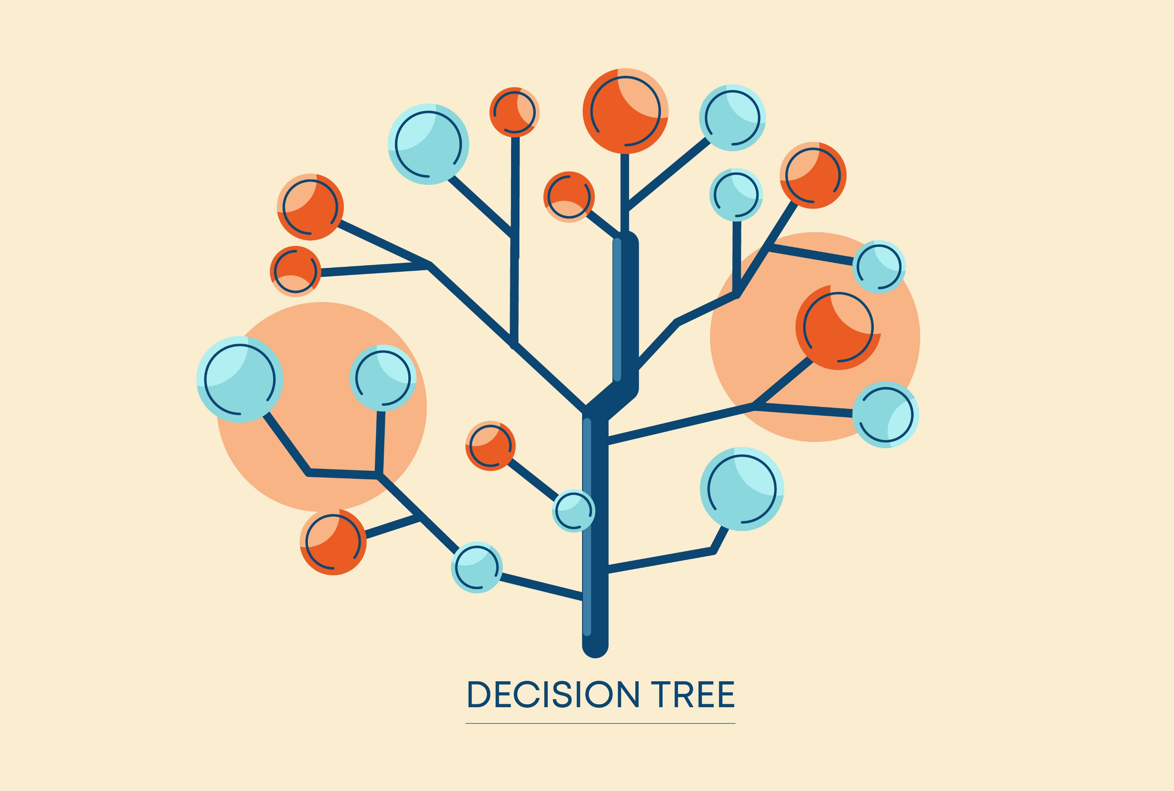
Decision Tree
A decision tree is a type of machine-learning algorithm that is used for both classification and regression tasks. It is a tree-like model that is constructed by recursively partitioning the data into subsets based on the values of the input features.
The "rpart" library in R is a package that provides a set of functions for fitting decision tree models using the Recursive Partitioning and Regression Trees (RPART) algorithm.
The "rpart" library provides functions for building decision trees, pruning the tree to avoid overfitting, and making predictions on new data.
the "rpart" library is a powerful tool for building and interpreting decision tree models in R. Its flexibility and ease of use make it a popular choice for data analysts and machine learning practitioners.

Slide 10
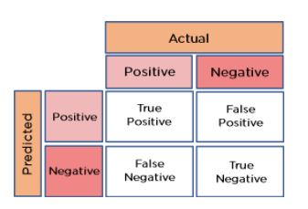
Model Evaluation – Confusion Matrix
A confusion matrix, also known as an error matrix, is a table that is used to compare the predicted class labels of a collection of data to the actual class labels in order to assess the effectiveness of a classification model. A confusion matrix has four elements:
True Positive (TP): The number of instances that are correctly classified as positive by the model.
False Positive (FP): The number of instances that are incorrectly classified as positive by the model.
False Negative (FN): The number of instances that are incorrectly classified as negative by the model.
True Negative (TN): The number of instances that are correctly classified as negative by the model.

Slide 11
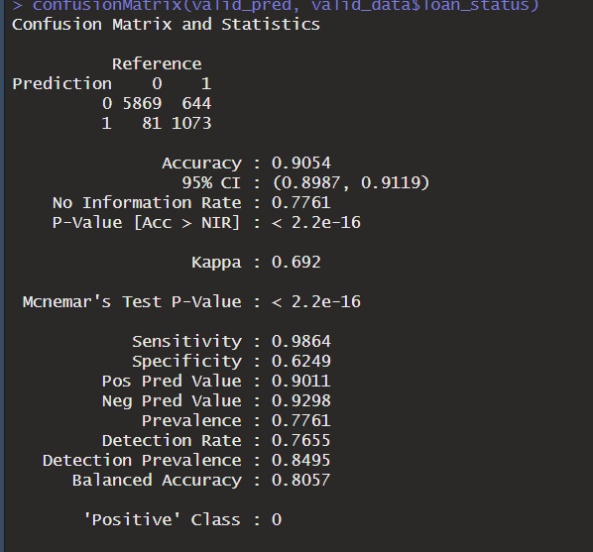
Performance Metrics
As this is a classification task, we use the confusion matrix to find the accuracy of our model
Confusion matrix consists of 4 important values to determine the accuracy, precision, and recall for a given dataset.
From the confusion matrix we can see that there are 5869 values that are True Positives and 1073 True Negatives.
That means there are 6942 values correctly predicted by the model.
The accuracy of the model on the validation set is 0.9054 ~ 90.54 %.

Slide 12
Closing Thoughts
From the statistical analysis, we can conclude that for any given data set, we can obtain an approximate accuracy of 90%.
Additionally, we can also look at the recall using the confusion matrix as per the business requirement if we need to find the aspect of people whose loan is rejected.

Slide 13


